Slide 1
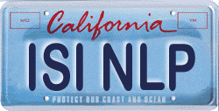
Language Translation and Code-Breaking
Kevin Knight
Information Sciences Institute & Computer Science Department
University of Southern California
joint work with:
Sujith Ravi, Qing Dou (USC), Beáta Megyesi, Christiane Schaefer (Uppsala)
Regina Barzilay, Ben Snyder (MIT), Sravana Reddy (Chicago)
Stanford University November 4, 2014

Slide 2
Machine Translation
美国关岛国际机场及其办公室均接获一名自称沙地阿拉伯富商拉登等发出的电子邮件，威胁将会向机场等公众地方发动生化袭击後，关岛经保持高度戒备。
Kowane mutum na da hakkin ya sami yancin yin tunani da na sanin yakamata da na bin addini; saboda haka yana da yancin sake addini ko ra'ayin da ya bada gaskiya gare shi, da kuma yancin nuna addininsa ko ra'ayinsa, shi daya ko a cikin taro kuma a fili ko a boye ta hanyar koyarwa ko yin ibada, ko bauta wa abin da ya bada gaskiya gare shi da yin
abubuwan da abin da yake bauta wa din ya nuna masa.

Slide 3
Machine Translation
美国关岛国际机场及其办公室均接获一名自称沙地阿拉伯富商拉登等发出的电子邮件，威胁将会向机场等公众地方发动生化袭击後，关岛经保持高度戒备。
Kowane mutum na da hakkin ya sami yancin yin tunani da na sanin yakamata da na bin addini; saboda haka yana da yancin sake addini ko ra'ayin da ya bada gaskiya gare shi, da kuma yancin nuna addininsa ko ra'ayinsa, shi daya ko a cikin taro kuma a fili ko a boye ta hanyar koyarwa ko yin ibada, ko bauta wa abin da ya bada gaskiya gare shi da yin
abubuwan da abin da yake bauta wa din ya nuna masa.
Chinese/
English
Hausa/
English
The U.S. island of Guam is maintaining a high state of alert after the Guam airport and its offices both received an e-mail from someone calling himself the Saudi Arabian Osama bin Laden and threatening a biological/chemical attack against public places such as the airport.
Everyone has the right to freedom of thought, conscience
and religion; this right includes freedom to change his
religion or belief, and freedom, either alone or in community
with others and in public or private, to manifest his religion
or belief in teaching, practice, worship and observance.

Slide 4
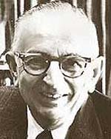
Statistical Machine Translation
“When I look at an article in Russian, I say: this is really written in English, but it has been coded in some strange symbols. I will now proceed to decode.” -- Warren Weaver (1947)
Weaver saw a colleague decoding intercepts into
Turkish, without “knowing” Turkish.
… maybe a computer could translate into English without “knowing” English?
OUR HERO

Slide 5

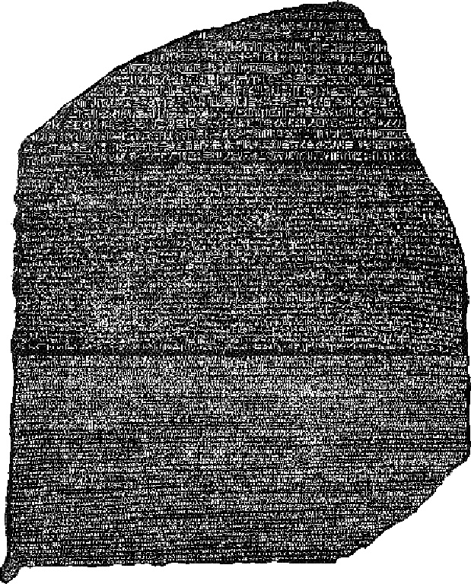
Statistical Machine Translation
Hmm, every time he sees
“banco”, he either types
“bank” or “bench” … but if
he sees “banco de…”,
he always types “bank”,
never “bench”…
Translate, translate …
Translated, parallel
documents

Slide 6
Parallel Corpus
12 English sentences in English and Spanish.
1a. Garcia and associates .
1b. Garcia y asociados .
7a. the clients and the associates are enemies .
7b. los clients y los asociados son enemigos .
2a. Carlos Garcia has three associates .
2b. Carlos Garcia tiene tres asociados .
8a. the company has three groups .
8b. la empresa tiene tres grupos .
3a. his associates are not strong .
3b. sus asociados no son fuertes .
9a. its groups are in Europe .
9b. sus grupos estan en Europa .
4a. Garcia has a company also .
4b. Garcia tambien tiene una empresa .
10a. the modern groups sell strong pharmaceuticals .
10b. los grupos modernos venden medicinas fuertes .
5a. its clients are angry .
5b. sus clientes estan enfadados .
11a. the groups do not sell zenzanine .
11b. los grupos no venden zanzanina .
6a. the associates are also angry .
6b. los asociados tambien estan enfadados .
12a. the small groups are not modern .
12b. los grupos pequenos no son modernos .

Slide 7
Parallel Corpus
12 English sentences in Centauri and Arcturan.
1a. ok-voon ororok sprok .
1b. at-voon bichat dat .
7a. lalok farok ororok lalok sprok izok enemok .
7b. wat jjat bichat wat dat vat eneat .
2a. ok-drubel ok-voon anok plok sprok .
2b. at-drubel at-voon pippat rrat dat .
8a. lalok brok anok plok nok .
8b. iat lat pippat rrat nnat .
3a. erok sprok izok hihok ghirok .
3b. totat dat arrat vat hilat .
9a. wiwok nok izok kantok ok-yurp .
9b. totat nnat quat oloat at-yurp .
4a. ok-voon anok drok brok jok .
4b. at-voon krat pippat sat lat .
10a. lalok mok nok yorok ghirok clok .
10b. wat nnat gat mat bat hilat .
5a. wiwok farok izok stok .
5b. totat jjat quat cat .
11a. lalok nok crrrok hihok yorok zanzanok .
11b. wat nnat arrat mat zanzanat .
6a. lalok sprok izok jok stok .
6b. wat dat krat quat cat .
12a. lalok rarok nok izok hihok mok .
12b. wat nnat forat arrat vat gat .

Slide 8
Centauri/Arcturan
Your assignment, translate this to Arcturan: farok crrrok hihok yorok clok kantok ok-yurp
1a. ok-voon ororok sprok .
1b. at-voon bichat dat .
7a. lalok farok ororok lalok sprok izok enemok .
7b. wat jjat bichat wat dat vat eneat .
2a. ok-drubel ok-voon anok plok sprok .
2b. at-drubel at-voon pippat rrat dat .
8a. lalok brok anok plok nok .
8b. iat lat pippat rrat nnat .
3a. erok sprok izok hihok ghirok .
3b. totat dat arrat vat hilat .
9a. wiwok nok izok kantok ok-yurp .
9b. totat nnat quat oloat at-yurp .
4a. ok-voon anok drok brok jok .
4b. at-voon krat pippat sat lat .
10a. lalok mok nok yorok ghirok clok .
10b. wat nnat gat mat bat hilat .
5a. wiwok farok izok stok .
5b. totat jjat quat cat .
11a. lalok nok crrrok hihok yorok zanzanok .
11b. wat nnat arrat mat zanzanat .
6a. lalok sprok izok jok stok .
6b. wat dat krat quat cat .
12a. lalok rarok nok izok hihok mok .
12b. wat nnat forat arrat vat gat .

Slide 9
Centauri/Arcturan
Your assignment, translate this to Arcturan: farok crrrok hihok yorok clok kantok ok-yurp
1a. ok-voon ororok sprok .
1b. at-voon bichat dat .
7a. lalok farok ororok lalok sprok izok enemok .
7b. wat jjat bichat wat dat vat eneat .
2a. ok-drubel ok-voon anok plok sprok .
2b. at-drubel at-voon pippat rrat dat .
8a. lalok brok anok plok nok .
8b. iat lat pippat rrat nnat .
3a. erok sprok izok hihok ghirok .
3b. totat dat arrat vat hilat .
9a. wiwok nok izok kantok ok-yurp .
9b. totat nnat quat oloat at-yurp .
4a. ok-voon anok drok brok jok .
4b. at-voon krat pippat sat lat .
10a. lalok mok nok yorok ghirok clok .
10b. wat nnat gat mat bat hilat .
5a. wiwok farok izok stok .
5b. totat jjat quat cat .
11a. lalok nok crrrok hihok yorok zanzanok .
11b. wat nnat arrat mat zanzanat .
6a. lalok sprok izok jok stok .
6b. wat dat krat quat cat .
12a. lalok rarok nok izok hihok mok .
12b. wat nnat forat arrat vat gat .

Slide 10
Centauri/Arcturan
Your assignment, translate this to Arcturan: farok crrrok hihok yorok clok kantok ok-yurp
1a. ok-voon ororok sprok .
1b. at-voon bichat dat .
7a. lalok farok ororok lalok sprok izok enemok .
7b. wat jjat bichat wat dat vat eneat .
2a. ok-drubel ok-voon anok plok sprok .
2b. at-drubel at-voon pippat rrat dat .
8a. lalok brok anok plok nok .
8b. iat lat pippat rrat nnat .
3a. erok sprok izok hihok ghirok .
3b. totat dat arrat vat hilat .
9a. wiwok nok izok kantok ok-yurp .
9b. totat nnat quat oloat at-yurp .
4a. ok-voon anok drok brok jok .
4b. at-voon krat pippat sat lat .
10a. lalok mok nok yorok ghirok clok .
10b. wat nnat gat mat bat hilat .
5a. wiwok farok izok stok .
5b. totat jjat quat cat .
11a. lalok nok crrrok hihok yorok zanzanok .
11b. wat nnat arrat mat zanzanat .
6a. lalok sprok izok jok stok .
6b. wat dat krat quat cat .
12a. lalok rarok nok izok hihok mok .
12b. wat nnat forat arrat vat gat .

Slide 11
Centauri/Arcturan
Your assignment, translate this to Arcturan: farok crrrok hihok yorok clok kantok ok-yurp
1a. ok-voon ororok sprok .
1b. at-voon bichat dat .
7a. lalok farok ororok lalok sprok izok enemok .
7b. wat jjat bichat wat dat vat eneat .
2a. ok-drubel ok-voon anok plok sprok .
2b. at-drubel at-voon pippat rrat dat .
8a. lalok brok anok plok nok .
8b. iat lat pippat rrat nnat .
3a. erok sprok izok hihok ghirok .
3b. totat dat arrat vat hilat .
9a. wiwok nok izok kantok ok-yurp .
9b. totat nnat quat oloat at-yurp .
4a. ok-voon anok drok brok jok .
4b. at-voon krat pippat sat lat .
10a. lalok mok nok yorok ghirok clok .
10b. wat nnat gat mat bat hilat .
5a. wiwok farok izok stok .
5b. totat jjat quat cat .
11a. lalok nok crrrok hihok yorok zanzanok .
11b. wat nnat arrat mat zanzanat .
???
6a. lalok sprok izok jok stok .
6b. wat dat krat quat cat .
12a. lalok rarok nok izok hihok mok .
12b. wat nnat forat arrat vat gat .

Slide 12
Centauri/Arcturan
Your assignment, translate this to Arcturan: farok crrrok hihok yorok clok kantok ok-yurp
1a. ok-voon ororok sprok .
1b. at-voon bichat dat .
7a. lalok farok ororok lalok sprok izok enemok .
7b. wat jjat bichat wat dat vat eneat .
2a. ok-drubel ok-voon anok plok sprok .
2b. at-drubel at-voon pippat rrat dat .
8a. lalok brok anok plok nok .
8b. iat lat pippat rrat nnat .
3a. erok sprok izok hihok ghirok .
3b. totat dat arrat vat hilat .
9a. wiwok nok izok kantok ok-yurp .
9b. totat nnat quat oloat at-yurp .
4a. ok-voon anok drok brok jok .
4b. at-voon krat pippat sat lat .
10a. lalok mok nok yorok ghirok clok .
10b. wat nnat gat mat bat hilat .
5a. wiwok farok izok stok .
5b. totat jjat quat cat .
11a. lalok nok crrrok hihok yorok zanzanok .
11b. wat nnat arrat mat zanzanat .
6a. lalok sprok izok jok stok .
6b. wat dat krat quat cat .
12a. lalok rarok nok izok hihok mok .
12b. wat nnat forat arrat vat gat .

Slide 13
Centauri/Arcturan
Your assignment, translate this to Arcturan: farok crrrok hihok yorok clok kantok ok-yurp
1a. ok-voon ororok sprok .
1b. at-voon bichat dat .
7a. lalok farok ororok lalok sprok izok enemok .
7b. wat jjat bichat wat dat vat eneat .
2a. ok-drubel ok-voon anok plok sprok .
2b. at-drubel at-voon pippat rrat dat .
8a. lalok brok anok plok nok .
8b. iat lat pippat rrat nnat .
3a. erok sprok izok hihok ghirok .
3b. totat dat arrat vat hilat .
9a. wiwok nok izok kantok ok-yurp .
9b. totat nnat quat oloat at-yurp .
4a. ok-voon anok drok brok jok .
4b. at-voon krat pippat sat lat .
10a. lalok mok nok yorok ghirok clok .
10b. wat nnat gat mat bat hilat .
5a. wiwok farok izok stok .
5b. totat jjat quat cat .
11a. lalok nok crrrok hihok yorok zanzanok .
11b. wat nnat arrat mat zanzanat .
6a. lalok sprok izok jok stok .
6b. wat dat krat quat cat .
12a. lalok rarok nok izok hihok mok .
12b. wat nnat forat arrat vat gat .

Slide 14
Centauri/Arcturan
Your assignment, translate this to Arcturan: farok crrrok hihok yorok clok kantok ok-yurp
1a. ok-voon ororok sprok .
1b. at-voon bichat dat .
7a. lalok farok ororok lalok sprok izok enemok .
7b. wat jjat bichat wat dat vat eneat .
2a. ok-drubel ok-voon anok plok sprok .
2b. at-drubel at-voon pippat rrat dat .
8a. lalok brok anok plok nok .
8b. iat lat pippat rrat nnat .
3a. erok sprok izok hihok ghirok .
3b. totat dat arrat vat hilat .
9a. wiwok nok izok kantok ok-yurp .
9b. totat nnat quat oloat at-yurp .
4a. ok-voon anok drok brok jok .
4b. at-voon krat pippat sat lat .
10a. lalok mok nok yorok ghirok clok .
10b. wat nnat gat mat bat hilat .
5a. wiwok farok izok stok .
5b. totat jjat quat cat .
11a. lalok nok crrrok hihok yorok zanzanok .
11b. wat nnat arrat mat zanzanat .
6a. lalok sprok izok jok stok .
6b. wat dat krat quat cat .
12a. lalok rarok nok izok hihok mok .
12b. wat nnat forat arrat vat gat .

Slide 15
Centauri/Arcturan
Your assignment, translate this to Arcturan: farok crrrok hihok yorok clok kantok ok-yurp
1a. ok-voon ororok sprok .
1b. at-voon bichat dat .
7a. lalok farok ororok lalok sprok izok enemok .
7b. wat jjat bichat wat dat vat eneat .
2a. ok-drubel ok-voon anok plok sprok .
2b. at-drubel at-voon pippat rrat dat .
8a. lalok brok anok plok nok .
8b. iat lat pippat rrat nnat .
3a. erok sprok izok hihok ghirok .
3b. totat dat arrat vat hilat .
9a. wiwok nok izok kantok ok-yurp .
9b. totat nnat quat oloat at-yurp .
4a. ok-voon anok drok brok jok .
4b. at-voon krat pippat sat lat .
10a. lalok mok nok yorok ghirok clok .
10b. wat nnat gat mat bat hilat .
???
5a. wiwok farok izok stok .
5b. totat jjat quat cat .
11a. lalok nok crrrok hihok yorok zanzanok .
11b. wat nnat arrat mat zanzanat .
6a. lalok sprok izok jok stok .
6b. wat dat krat quat cat .
12a. lalok rarok nok izok hihok mok .
12b. wat nnat forat arrat vat gat .

Slide 16
Centauri/Arcturan
Your assignment, translate this to Arcturan: farok crrrok hihok yorok clok kantok ok-yurp
1a. ok-voon ororok sprok .
1b. at-voon bichat dat .
7a. lalok farok ororok lalok sprok izok enemok .
7b. wat jjat bichat wat dat vat eneat .
2a. ok-drubel ok-voon anok plok sprok .
2b. at-drubel at-voon pippat rrat dat .
8a. lalok brok anok plok nok .
8b. iat lat pippat rrat nnat .
3a. erok sprok izok hihok ghirok .
3b. totat dat arrat vat hilat .
9a. wiwok nok izok kantok ok-yurp .
9b. totat nnat quat oloat at-yurp .
4a. ok-voon anok drok brok jok .
4b. at-voon krat pippat sat lat .
10a. lalok mok nok yorok ghirok clok .
10b. wat nnat gat mat bat hilat .
5a. wiwok farok izok stok .
5b. totat jjat quat cat .
11a. lalok nok crrrok hihok yorok zanzanok .
11b. wat nnat arrat mat zanzanat .
6a. lalok sprok izok jok stok .
6b. wat dat krat quat cat .
12a. lalok rarok nok izok hihok mok .
12b. wat nnat forat arrat vat gat .

Slide 17
Centauri/Arcturan
Your assignment, translate this to Arcturan: farok crrrok hihok yorok clok kantok ok-yurp
1a. ok-voon ororok sprok .
1b. at-voon bichat dat .
7a. lalok farok ororok lalok sprok izok enemok .
7b. wat jjat bichat wat dat vat eneat .
2a. ok-drubel ok-voon anok plok sprok .
2b. at-drubel at-voon pippat rrat dat .
8a. lalok brok anok plok nok .
8b. iat lat pippat rrat nnat .
3a. erok sprok izok hihok ghirok .
3b. totat dat arrat vat hilat .
9a. wiwok nok izok kantok ok-yurp .
9b. totat nnat quat oloat at-yurp .
4a. ok-voon anok drok brok jok .
4b. at-voon krat pippat sat lat .
10a. lalok mok nok yorok ghirok clok .
10b. wat nnat gat mat bat hilat .
process of
elimination
5a. wiwok farok izok stok .
5b. totat jjat quat cat .
11a. lalok nok crrrok hihok yorok zanzanok .
11b. wat nnat arrat mat zanzanat .
6a. lalok sprok izok jok stok .
6b. wat dat krat quat cat .
12a. lalok rarok nok izok hihok mok .
12b. wat nnat forat arrat vat gat .

Slide 18
Statistical Machine Translation
1999
one page per day, low quality
limited domains, languages
no commercial offerings
2014
fast, 50+ languages
quality much improved
products for business, intelligence, end users
أعلن الرئيس الصومالي شريف شيخ أحمد أثناء زيارة لمواقع للقوات الحكومية والأفريقية في حي هودن في مقديشو أن الحملة العسكرية الحالية "لن تتوقف حتى تتحرر الصومال من الشباب والقاعدة".
Somali President Sharif Sheikh Ahmed during a visit to sites of government forces and African in the district of Howden in Mogadishu that the current military campaign "will not stop until Somalia is liberated from the youth and al-Qaeda. "

Slide 19
Learning Translation Knowledge from Parallel Text
Parallel text
Translation model
(bilingual dictionary,
re-ordering patterns, etc)

Slide 20
Learning Translation Knowledge from Non-Parallel Text?
Parallel text
English text
Albanian text
Can we automatically
decipher Albanian into
English, without a
“Rosetta Stone”?
?
Translation model
(bilingual dictionary,
re-ordering patterns, etc)
Translation model
(bilingual dictionary,
re-ordering patterns, etc)

Slide 21
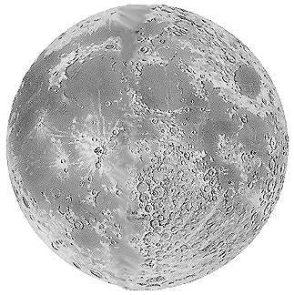
African Languages
almost
as big as
the Moon
CONTINENTAL UNITED STATES
INDIA
AND
PAKISTAN
ALASKA
GREENLAND
SOUTHEAST
ASIA
Zero languages
spoken
EUROPEAN
UNION
1000+ languages
spoken,
40+ by 1m+
speakers
JAPAN
UKRAINE
CENT.
AMERICA
MEXICO

Slide 22
Translation as Decipherment? Our Cryptographic Roots
Automating Cryptography (1930s)
Cracking German Enigma Cipher
“First NLP
problem”
Proto-Computers
Information Theory
Speech Recognition
Machine Translation

Slide 23
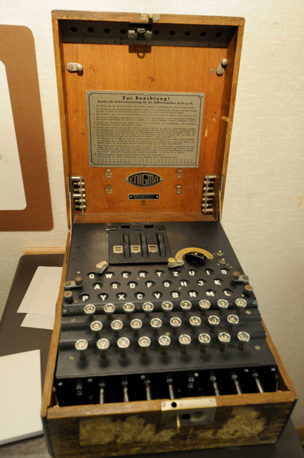
German Enigma Cipher Machine (1920s-1940s)
over the
radio:
DRKWI FKSLW
ORISJ DKSUE
IFKRP ...
German
text →
German
→ text
→
→
input (intercepted ciphertext): DRKWI FKSLW ORISJ DKSUE IFK …
output (plaintext): VASIS TDASH ERRCA PITAN RIC …

Slide 24
German Enigma Cipher Machine
Secret key =
initial rotor
ordering and
settings
Substitution system
N → J
Reversible behavior
NNN → JTE → NNN
Substitution table changes
with every keystroke:
NNN → JTE

Slide 25
Breaking Enigma
cipher
text
substitution
proposed
plaintext
German
Is it German?
guessed
key

Slide 26
Breaking Enigma
cipher
text
substitution
proposed
plaintext
German
Is it German?
guessed
key
Statistical aligner
cipher
text
plain
text

Slide 27
Breaking Enigma
cipher
text
substitution
proposed
plaintext
German
Is it German?
guessed
key
You are wimps!
Statistical aligner
cipher
text
plain
text
SHANNON TURING KULLBACK

Slide 28
Breaking Enigma
cipher
text
substitution
proposed
plaintext
German
Is it German?
guessed
key
SHANNON TURING KULLBACK

Slide 29
Breaking Enigma
cipher
text
substitution
proposed
plaintext
German
Is it German?
guessed
key
POLISH CIPHER BUREAU &
BLETCHLEY PARK
LOOK FOR ENIGMA
SETTINGS THAT YIELD PLAINTEXT PATTERN
“XYZXYZ…”
BOMBE

Slide 30
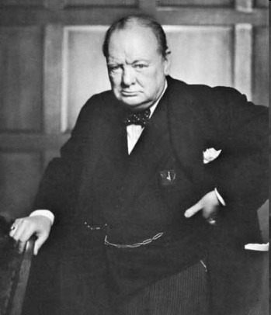
Breaking Enigma
cipher
text
substitution
proposed
plaintext
German
Is it German?
guessed
key
?
?
?
?
POLISH CIPHER BUREAU &
BLETCHLEY PARK
LOOK FOR ENIGMA
SETTINGS THAT YIELD PLAINTEXT PATTERN
“XYZXYZ…”
WINSTON
CHURCHILL
BOMBE

Slide 31
Plan for This Talk
Break a series of codes
Letter substitution
Phonetic substitution
archaeology
transliteration
Word substitution
Foreign language as cipher
Bonus
Two historical ciphers
Final thought on translation and cryptography

Slide 32
Plan for This Talk
Break a series of codes
Letter substitution
Phonetic substitution
archaeology
transliteration
Word substitution
Foreign language as cipher
Bonus
Two historical ciphers
Final thought on translation and cryptography
YOU
ARE
HERE

Slide 33
Letter Substitution Cipher
Encipherment key:
PLAIN: ABCDEFGHIJKLMNOPQRSTUVWXYZ
CIPHER: PLOKMIJNUHBYGVTFCRDXESZAQW
Plaintext: HELLO WORLD ...
Ciphertext: NMYYT ZTRYK ...
Key itself doesn’t change: “simple substitution”
What key, if applied to the ciphertext, would yield sensible plaintext?

Slide 34
KDCY LQZKTLJKX CY MDBCYJQL: “TR
HYD FKXC, FQ MKX RLQQIQ HYDL
MKL DXCTW RDCDLQ JQMNKXTMB
PTBMYEQL K FKH CY LQZKTL TC.”

Slide 35
KDCY LQZKTLJKX CY MDBCYJQL: “TR
HYD FKXC, FQ MKX RLQQIQ HYDL
MKL DXCTW RDCDLQ JQMNKXTMB
PTBMYEQL K FKH CY LQZKTL TC.”
A
B 3
C 8
D 7
E 1
F 3
G
H 3
I 1
J 3
K 10
L 10
M 6
N 1
O
P 1
Q 10
R 3
S
T 7
U
V
W 1
X 5
Y 7
Z 2

Slide 36
. . . .
KDCY LQZKTLJKX CY MDBCYJQL: “TR
. . . . . .
HYD FKXC, FQ MKX RLQQIQ HYDL
. . . .
MKL DXCTW RDCDLQ JQMNKXTMB
. . . . .
PTBMYEQL K FKH CY LQZKTL TC.”
A
B 3
C 8
D 7
E 1 .
F 3 .
G
H 3 .
I 1 .
J 3 .
K 10
L 10
M 6
N 1 .
O
P 1 .
Q 10
R 3 .
S
T 7
U
V
W 1 .
X 5
Y 7
Z 2 .

Slide 37
. . . .
KDCY LQZKTLJKX CY MDBCYJQL: “TR
. . . . . .
HYD FKXC, FQ MKX RLQQIQ HYDL
. . . .
MKL DXCTW RDCDLQ JQMNKXTMB
. . . . .
PTBMYEQL K FKH CY LQZKTL TC.”
A
B 3
C 8
D 7 #
E 1 .
F 3 .
G
H 3 .
I 1 .
J 3 .
K 10 ##### V
L 10 ##
M 6 #
N 1 .
O
P 1 .
Q 10 ######### V
R 3 .
S
T 7 ### V
U
V
W 1 .
X 5
Y 7 #### V
Z 2 .

Slide 38
a .a .a . .
KDCY LQZKTLJKX CY MDBCYJQL: “TR
. .a . a . . .
HYD FKXC, FQ MKX RLQQIQ HYDL
a . . . .a
MKL DXCTW RDCDLQ JQMNKXTMB
. . a .a. .a
PTBMYEQL K FKH CY LQZKTL TC.”
A
B 3
C 8
D 7 #
E 1 .
F 3 .
G
H 3 .
I 1 .
J 3 .
K 10 ##### V
L 10 ##
M 6 #
N 1 .
O
P 1 .
Q 10 ######### V
R 3 .
S
T 7 ### V
U
V
W 1 .
X 5
Y 7 #### V
Z 2 .

Slide 39
a e.a .a .e .
KDCY LQZKTLJKX CY MDBCYJQL: “TR
. .a .e a . ee.e .
HYD FKXC, FQ MKX RLQQIQ HYDL
a . . e .e .a
MKL DXCTW RDCDLQ JQMNKXTMB
. .e a .a. e.a
PTBMYEQL K FKH CY LQZKTL TC.”
A
B 3
C 8
D 7 #
E 1 .
F 3 .
G
H 3 .
I 1 .
J 3 .
K 10 ##### V
L 10 ##
M 6 #
N 1 .
O
P 1 .
Q 10 ######### V
R 3 .
S
T 7 ### V
U
V
W 1 .
X 5
Y 7 #### V
Z 2 .
didn’t create “ae”

Slide 40
a e.ao .a .e o.
KDCY LQZKTLJKX CY MDBCYJQL: “TR
. .a .e a . ee.e .
HYD FKXC, FQ MKX RLQQIQ HYDL
a o. . e .e .a o
MKL DXCTW RDCDLQ JQMNKXTMB
.o .e a .a. e.ao o
PTBMYEQL K FKH CY LQZKTL TC.”
A
B 3
C 8
D 7 #
E 1 .
F 3 .
G
H 3 .
I 1 .
J 3 .
K 10 ##### V
L 10 ##
M 6 #
N 1 .
O
P 1 .
Q 10 ######### V
R 3 .
S
T 7 ### V
U
V
W 1 .
X 5
Y 7 #### V
Z 2 .
don’t like “ao” – back up!

Slide 41
a o e.a .a o o.e .
KDCY LQZKTLJKX CY MDBCYJQL: “TR
.o .a .e a . ee.e .o
HYD FKXC, FQ MKX RLQQIQ HYDL
a . . e .e .a
MKL DXCTW RDCDLQ JQMNKXTMB
. o.e a .a. o e.a
PTBMYEQL K FKH CY LQZKTL TC.”
A
B 3
C 8
D 7 #
E 1 .
F 3 .
G
H 3 .
I 1 .
J 3 .
K 10 ##### V
L 10 ##
M 6 #
N 1 .
O
P 1 .
Q 10 ######### V
R 3 .
S
T 7 ### V
U
V
W 1 .
X 5
Y 6 #### V
Z 2 .

Slide 42
a o re.a r.a o o.e f
KDCY LQZKTLJKX CY MDBCYJQL: “TR
.o .a .e a freeze .o r
HYD FKXC, FQ MKX RLQQIQ HYDL
ar . f re .e .a
MKL DXCTW RDCDLQ JQMNKXTMB
. o.er a .a. o re.a r
PTBMYEQL K FKH CY LQZKTL TC.”
A
B 3
C 8
D 7 #
E 1 .
F 3 .
G
H 3 .
I 1 .
J 3 .
K 10 ##### V
L 10 ##
M 6 #
N 1 .
O
P 1 .
Q 10 ######### V
R 3 .
S
T 7 ### V
U
V
W 1 .
X 5
Y 6 #### V
Z 2 .

Slide 43
a o re.a r.a o o.e f
KDCY LQZKTLJKX CY MDBCYJQL: “TR
.o .a .e a freeze .o r
HYD FKXC, FQ MKX RLQQIQ HYDL
ar . f re .e .a
MKL DXCTW RDCDLQ JQMNKXTMB
. o.er a .a. o re.a r
PTBMYEQL K FKH CY LQZKTL TC.”
A
B 3
C 8
D 7 #
E 1 .
F 3 .
G
H 3 .
I 1 .
J 3 .
K 10 ##### V
L 10 ##
M 6 #
N 1 .
O
P 1 .
Q 10 ######### V
R 3 .
S
T 7 ### V
U
V
W 1 .
X 5
Y 6 #### V
Z 2 .
frequent cipher letters: Q L K C D T M Y X
frequent English letters: e t o a n i r s h

Slide 44
a no re.air.a no no.e if
KDCY LQZKTLJKX CY MDBCYJQL: “TR
.o .a n .e a freeze .o r
HYD FKXC, FQ MKX RLQQIQ HYDL
ar ni. f n re .e .a i
MKL DXCTW RDCDLQ JQMNKXTMB
.i o.er a .a. no re.air in
PTBMYEQL K FKH CY LQZKTL TC.”
A
B 3
C 8
D 7 #
E 1 .
F 3 .
G
H 3 .
I 1 .
J 3 .
K 10 ##### V
L 10 ##
M 6 #
N 1 .
O
P 1 .
Q 10 ######### V
R 3 .
S
T 7 ### V
U
V
W 1 .
X 5
Y 6 #### V
Z 2 .
frequent cipher letters: Q L K C D T M Y X
frequent English letters: e t o a n i r s h

Slide 45
a to re.air.a to to.e if
KDCY LQZKTLJKX CY MDBCYJQL: “TR
.o .a t .e a freeze .o r
HYD FKXC, FQ MKX RLQQIQ HYDL
ar ti. f t re .e .a i
MKL DXCTW RDCDLQ JQMNKXTMB
.i o.er a .a. to re.air it
PTBMYEQL K FKH CY LQZKTL TC.”
A
B 3
C 8
D 7 #
E 1 .
F 3 .
G
H 3 .
I 1 .
J 3 .
K 10 ##### V
L 10 ##
M 6 #
N 1 .
O
P 1 .
Q 10 ######### V
R 3 .
S
T 7 ### V
U
V
W 1 .
X 5
Y 6 #### V
Z 2 .
frequent cipher letters: Q L K C D T M Y X
frequent English letters: e t o a n i r s h

Slide 46
a to repair.a to to.e if
KDCY LQZKTLJKX CY MDBCYJQL: “TR
.o .a t .e a freeze .o r
HYD FKXC, FQ MKX RLQQIQ HYDL
ar ti. f t re .e .a i
MKL DXCTW RDCDLQ JQMNKXTMB
.i o.er a .a. to repair it
PTBMYEQL K FKH CY LQZKTL TC.”
A
B 3
C 8
D 7 #
E 1 .
F 3 .
G
H 3 .
I 1 .
J 3 .
K 10 ##### V
L 10 ##
M 6 #
N 1 .
O
P 1 .
Q 10 ######### V
R 3 .
S
T 7 ### V
U
V
W 1 .
X 5
Y 6 #### V
Z 2 .
frequent cipher letters: Q L K C D T M Y X
frequent English letters: e t o a n i r s h

Slide 47
auto repairman to customer: if
KDCY LQZKTLJKX CY MDBCYJQL: “TR
you want we can freeze your
HYD FKXC, FQ MKX RLQQIQ HYDL
car until future mechanics
MKL DXCTW RDCDLQ JQMNKXTMB
discover a way to repair it
PTBMYEQL K FKH CY LQZKTL TC.”
A
B 3
C 8
D 7 #
E 1 .
F 3 .
G
H 3 .
I 1 .
J 3 .
K 10 ##### V
L 10 ##
M 6 #
N 1 .
O
P 1 .
Q 10 ######### V
R 3 .
S
T 7 ### V
U
V
W 1 .
X 5
Y 6 #### V
Z 2 .

Slide 48
Letter Substitution Cipher
ciphertext c

Slide 49
Letter Substitution Cipher
plaintext p
ciphertext c
P(p)
P(c | p)
“key”

Slide 50
Letter Substitution Cipher
plaintext samples,
unrelated to ciphertext
plaintext p
ciphertext c
P(p)
P(c | p)
“key”

Slide 51
Letter Substitution Cipher
plaintext samples,
unrelated to ciphertext
FREEZE
plaintext p
ciphertext c
P(p)
P(c | p)
“key”

Slide 52
Letter Substitution Cipher
FREEZE
plaintext p
ciphertext c
P(p)
P(c | p)
“key”

Slide 53
Letter Substitution Cipher
Find substitution-table values
that maximize
P(c) = Σ_{p} P(p, c)
= Σ_{p} P(p) P(c | p)
ciphertext c
FREEZE
plaintext p
ciphertext c
P(p)
P(c | p)
“key”

Slide 54
Letter Substitution Cipher
Find substitution-table values
that maximize
P(c) = Σ_{p} P(p, c)
= Σ_{p} P(p) P(c | p)
ciphertext c
FREEZE
plaintext p
FREEZE
ciphertext c
P(p)
P(c | p)
“key”
best guess
plaintext p
DECODE
Find plaintext p that maximizes
P(p | c) ∼ P(p) P(c | p)

Slide 55
Letter Substitution Cipher
Find substitution-table values
that maximize
P(c) = Σ_{p} P(p, c)
= Σ_{p} P(p) P(c | p)
plaintext samples,
unrelated to ciphertext
ciphertext c
LM
EM
plaintext p
ciphertext c
P(p)
P(c | p)
“key”
best guess
plaintext p
Viterbi
Find plaintext p that maximizes
P(p | c) ∼ P(p) P(c | p)

Slide 56
Decipherment Accuracy vs. Cipher Length
2-gram
3-gram

Slide 57
Letter Substitution Cipher
Find substitution-table values
that maximize
P(c) = Σ_{p} P(p, c)
= Σ_{p} P(p)^{0.5} P(c | p)
plaintext samples,
unrelated to ciphertext
ciphertext c
LM
EM
[Ravi & Knight 09b]
plaintext p
ciphertext c
P(p)
P(c | p)
“key”
best guess
plaintext p
Viterbi
Find plaintext p that maximizes
P(p | c) ∼ P(p) P(c | p)³
[Knight/Yamada 99]

Slide 58
Reducing LM Weight During EM
Set EM to maximize
P(c) ≈ Σ_{p} P(p)^{0.5} P(c | p)
instead of
P(c) ≈ Σ_{p} P(p) P(c | p)
2-gram
3-gram
3-gram
7-gram
[Ravi & Knight 09b]

Slide 59
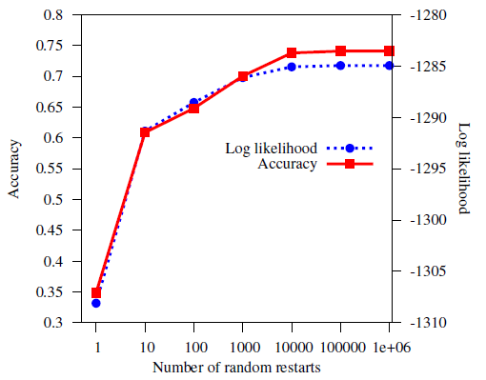
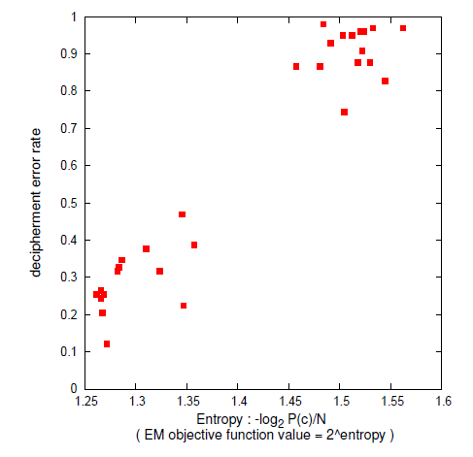
Random Restarts are Critical
Zodiac killer 340 cipher
English 98-letter cipher, 3-gram LM
[Ravi & Knight 09b]
[Berg-Kirkpatrick & Klein 13]

Slide 60
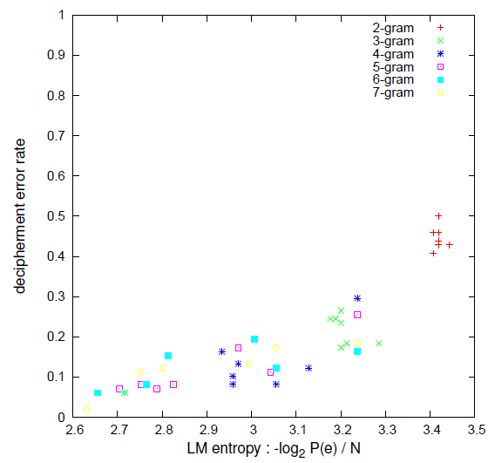
Good Language Models are Critical
English 98-letter cipher
[Ravi & Knight 09b]

Slide 61
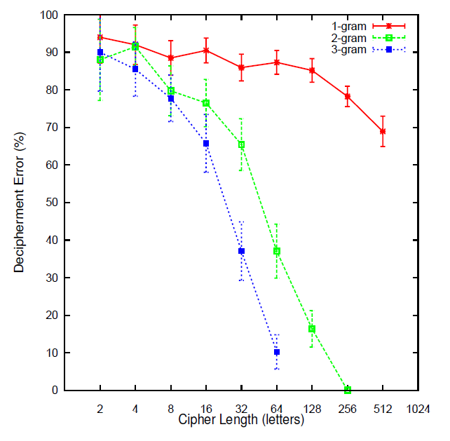
Deterministic Substitution Constraint Using ILP instead of EM
* Search only over
deterministic keys.
* Exact, no restarts.
Cipher Length | EM error | ILP error
52 | 85 % | 21 %
98 | 45 % | 12 %
414 | 10 % | 0.5 %
[Ravi & Knight 08]
Using 2-gram letter-based LM
see also [Nuhn, Ney, Schamper] on beam search

Slide 62
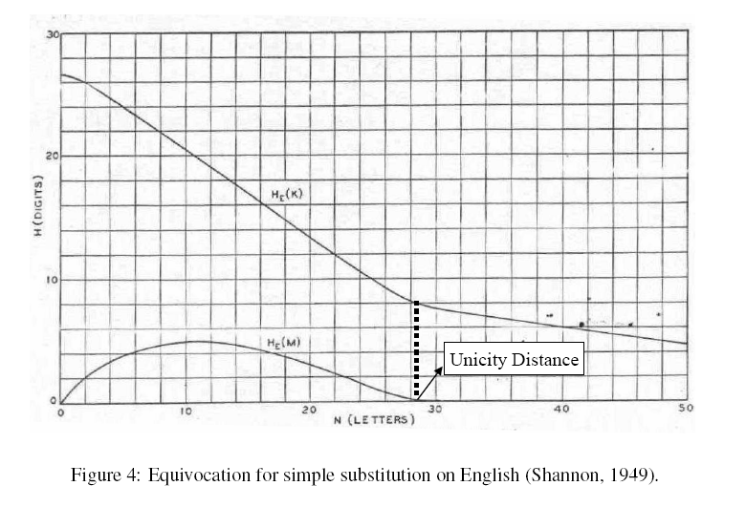
[Shannon 46, 49] “Communication Theory of Secrecy Systems”
Shannon analytically predicted uncertainty about key and message
Graphed it for a human-level language model
Entropy of key, H(K|C)
Entropy of plaintext message, H(M|C)
ENTROPY
(DECIMAL DIGITS)
Unicity distance = H(K) / (4.7 – LMCE)
CIPHER LENGTH (LETTERS)
log₂ 26!
~1.6 bits/char
for a human

Slide 63
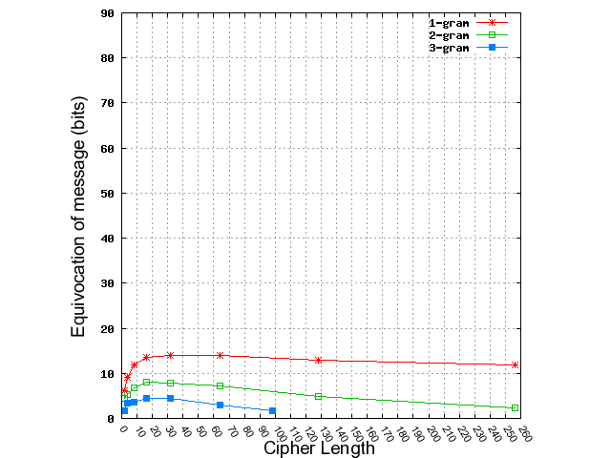
Verifying Shannon’s Prediction of Plaintext Message Uncertainty
LM | Analytically Predicted Unicity Distance
1-gram | 173
2-gram | 74
3-gram | 50
Human | 28
for Human Language Model
ANALYTIC CURVES ACTUAL CURVES
(Shannon’s) (ours)
[Ravi & Knight 08]

Slide 64
Plan for This Talk
Break a series of codes
Simple letter substitution
Phonetic substitution
archaeology
transliteration
Word substitution
Foreign language as cipher
Bonus
Two historical ciphers
Final thought on translation and cryptography
YOU
ARE
HERE

Slide 65
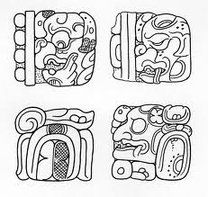
Phonetic Decipherment
ciphertext
[Knight & Yamada 99]

Slide 66
Phonetic Decipherment
ciphertext
primera parte
del ingenioso
hidalgo don …
[Knight & Yamada 99]

Slide 67
Phonetic Decipherment
“When I look at these squiggles, I say to myself, this is really a sequence of Spanish phonemes, but it has been encoded in some strange symbols…”
ciphertext
primera parte
del ingenioso
hidalgo don …
(Don Quixote)
OUR HERO
[Knight & Yamada 99]

Slide 68
Phonetic Decipherment
ciphertext
primera parte
del ingenioso
hidalgo don …
(Don Quixote)
Modern
Spanish
sounds
?
Phoneme
trigram model
P(L | tS a) = 0.03
Phoneme-to-
letter model
P(y | L) = ?
26 sounds:
B, D, G, J (canyon),
L (yarn), T (thin), a,
b, d, e, f, g, i, k, l,
m, n, o, p , r,
rr (trilled), s,
t, tS, u, x (hat)
32 letters:
ñ, á, é, í, ó, ú,
a, b, c, d, e, f, g,
h, i, j, k, l, m, n,
o, p, q, r, s, t, u
v, w, x, y, z
?
EM approach = 93% accurate phonetic decipherment
[Knight & Yamada 99]

Slide 69
What if Spoken Language Behind Script is Unknown?
Build a universal model P(p) of human phoneme sequence production
human might generally say: K AH N AH R IY
human won’t generally say: R T R K L K
Find a P(c | p) table
such that there is a decoding with a good universal P(p) score
Phoneme & syllable inventory
if z, then s
all have CV syllables; if VCC, then also VC
Syllable sonority structure
dram, lomp, ? rdam, ? lopm
Physiological preference constraints
tomp, tont, ? tomk, ? tonp
[Knight et al 06]

Slide 70
Unknown Source Language
# of
syllables
in word
syllable
type
sequence
consonant/
vowel
sequences
primera parte
del ingenioso
hidalgo don …
P(1) = ?
P(2) = ?
etc.
P(CV) = ?
P(V) = ?
P(CVC) = ?
+ 7 others
P(V | V) = ?
P(VV | V) = ?
P(a | V) = ?
P(a | C) = ?
etc.
Input: primera parte del ingenioso …
Output: NSV.NV.NV NVS.NV NVS VS.NV.SV.V.NV …
S = sonorous consonant phoneme
N = non-sonorous consonant phoneme
V = vowel phoneme
[Knight et al 06]
see also
[Kim & Snyder 13]

Slide 71
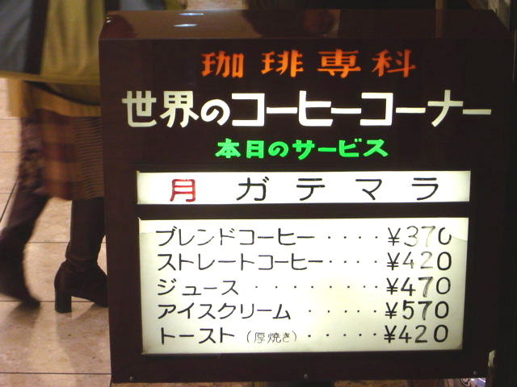
Phoneme Substitution Ciphers
When I look at street signs in Tokyo, I say: this is really written in English, but it has been coded in some strange symbols. I will now proceed to decode!
Parallel data: [Knight & Graehl 97]
Non-parallel data: [Ravi & Knight 09a]
OUR HERO

Slide 72
Plan for This Talk
Break a series of codes
Simple letter substitution
Phonetic substitution
archaeology
transliteration
Word substitution
Foreign language as cipher
Bonus
Two historical ciphers
Final thought on translation and cryptography
YOU
ARE
HERE

Slide 73
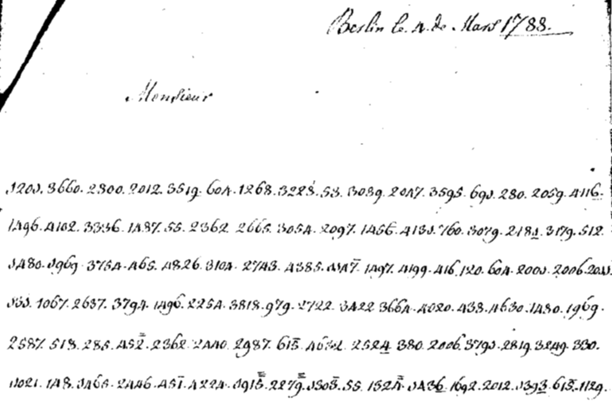
Word Substitution
Each code number represents
a plaintext word, not letter

Slide 74
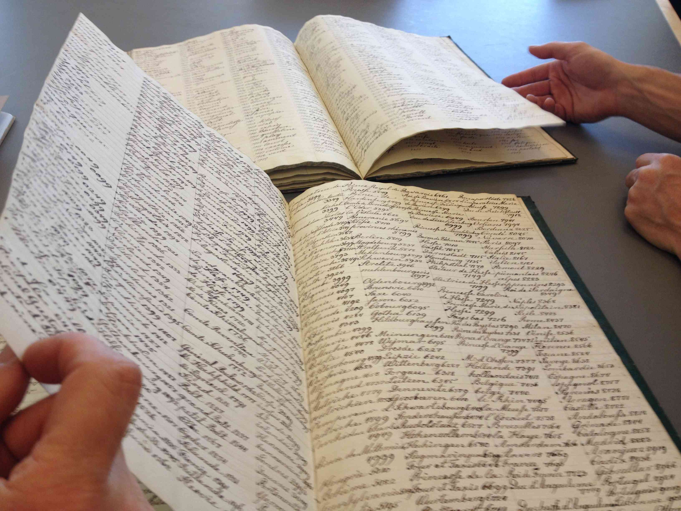
Word Substitution Keys
Decipherment Key
Encipherment Key

Slide 75
Foreign Language as a Cipher
رفض رئيس السلطة الفلسطينية محمود عباس مجددا تصريحات وزير الخارجية الإسرائيلي سيلفان شالوم التي قال فيها إنه يتعين على إسرائيل إعادة النظر في انسحابها من غزة، المقرر أن يتم الصيف المقبل إذا فازت حركة المقاومة الإسلامية حماس في الانتخابات التشريعية.
وقال عباس في مؤتمر صحفي على هامش مشاركته في القمة العربية-اللاتينية الأولى إنه يتعين على إسرائيل احترام خيار الشعب الفلسطيني حتى لو فازت حماس بالانتخابات، وأضاف "إذا نجحت حماس أو فتح سيكون هذا خيار الشعب الفلسطيني، وعلى الجميع قبول هذا الخيار بكل ترحاب".
من جانبه شجب رئيس الحكومة الفلسطينية أحمد قريع الطابع الأحادي الجانب للانسحاب الإسرائيلي من غزة، وأكد أن إسرائيل تريد مغادرة هذه الأراضي لتعزيز سيطرتها على الضفة الغربية.
وقال قريع في كلمة له خلال مؤتمر نظمته وزارة الأوقاف في رام الله "سينسحبون من غزة ولكننا لا نعرف ما هو شكل هذا الانسحاب وماذا سيتركون، وما هو مصير المعابر والحدود, وكل ذلك غامض لأنه قرار أحادي الجان

Slide 76
Foreign Language as a Cipher
“When I look at this giant corpus of Arabic, I say to myself, this is really English, but it has been encoded in some strange symbols!!! Let’s decode!!!”
OUR
HERO
رفض رئيس السلطة الفلسطينية محمود عباس مجددا تصريحات وزير الخارجية الإسرائيلي سيلفان شالوم التي قال فيها إنه يتعين على إسرائيل إعادة النظر في انسحابها من غزة، المقرر أن يتم الصيف المقبل إذا فازت حركة المقاومة الإسلامية حماس في الانتخابات التشريعية.
وقال عباس في مؤتمر صحفي على هامش مشاركته في القمة العربية-اللاتينية الأولى إنه يتعين على إسرائيل احترام خيار الشعب الفلسطيني حتى لو فازت حماس بالانتخابات، وأضاف "إذا نجحت حماس أو فتح سيكون هذا خيار الشعب الفلسطيني، وعلى الجميع قبول هذا الخيار بكل ترحاب".
من جانبه شجب رئيس الحكومة الفلسطينية أحمد قريع الطابع الأحادي الجانب للانسحاب الإسرائيلي من غزة، وأكد أن إسرائيل تريد مغادرة هذه الأراضي لتعزيز سيطرتها على الضفة الغربية.
وقال قريع في كلمة له خلال مؤتمر نظمته وزارة الأوقاف في رام الله "سينسحبون من غزة ولكننا لا نعرف ما هو شكل هذا الانسحاب وماذا سيتركون، وما هو مصير المعابر والحدود, وكل ذلك غامض لأنه قرار أحادي الجان
plaintext e
P(e)
P(f | e)

Slide 77
Time Expressions
!l@!m
!lywm
!lth!ny&
!l@!m !lm!Dy
Sfr
@!m
th!ny&
@!m 1992
@!m 1993
ywm
!l!sbw@ !lm!Dy
fy !ldqyq&
!lsn& !lj!ry&
!lsn&
!lsh=hr !lm!Dy
!lsh=hr !lj!ry
snw!t
sn&
=hdh! !l@!m
s!@&
!l@Sr
@!m 1991
!l@Swr
=hdh! !lsh=hr
fy ywm
nys!n
!sbw@
=hdh=h !l!'y!m
qbl !'y!m
fy !l@Sr
mn !lsn&
!lsnw!t
b@d ywm
!l!y!m
13 nys!n 1994
!lth!ny& @shr&
thl!th& !y!m
qbl !sbw@yn
fy !lywm !lt!ly
sh@b!n
tmwz
3 dhw !lHj& 1414
fy shb!T !lm!Dy
qbl ywmyn
@!m 1990
w!lth!ny&
fy !lywm
mn !lsh=hr !lj!ry
!lqrn
!'y!m
@!m!aN
!ls!@&
17 shb!T 1994
thl!th snw!t
dqyq&
=hdh=h !lsn&
ywmyn
mn !l@!m !lm!Dy
!lsn& !lmqbl&
fy !lsn&
kl ywm
fy !l@!m !lm!Dy

Slide 78
Time Expressions
!l@!m
!lywm
!lth!ny&
!l@!m !lm!Dy
Sfr
@!m
th!ny&
@!m 1992
@!m 1993
ywm
!l!sbw@ !lm!Dy
fy !ldqyq&
!lsn& !lj!ry&
!lsn&
!lsh=hr !lm!Dy
!lsh=hr !lj!ry
snw!t
sn&
=hdh! !l@!m
s!@&
!l@Sr
@!m 1991
!l@Swr
=hdh! !lsh=hr
fy ywm
nys!n
!sbw@
=hdh=h !l!'y!m
qbl !'y!m
fy !l@Sr
mn !lsn&
!lsnw!t
b@d ywm
!l!y!m
13 nys!n 1994
!lth!ny& @shr&
thl!th& !y!m
qbl !sbw@yn
fy !lywm !lt!ly
sh@b!n
tmwz
3 dhw !lHj& 1414
fy shb!T !lm!Dy
qbl ywmyn
@!m 1990
w!lth!ny&
fy !lywm
mn !lsh=hr !lj!ry
!lqrn
!'y!m
@!m!aN
!ls!@&
17 shb!T 1994
thl!th snw!t
dqyq&
=hdh=h !lsn&
ywmyn
mn !l@!m !lm!Dy
!lsn& !lmqbl&
fy !lsn&
kl ywm
fy !l@!m !lm!Dy

Slide 79
Time Expressions
<n><n>* ??? 19<n><n>
9 Hzyr!n 1942
8 tshryn !l!wl 1990
7 k!nwn !l!wl 1993
6 !'y!r 1993
6 !~Adh!r 1991
5 shb!T 1950
4 Hzyr!n 1989
30 !~Adh!r 1944
29 !y!r 1945
29 !~Adh!r 1993
28 k!nwn !l!'wl 1994
27 tmwz 1993
26 tmwz 1953
26 shb!T 1993
26 k!nwn !l!wl 1994
25 !ylwl 1926
24 !~Adh!r 1993
22 !ylwl 1957
22 tshryn !l!wl 1948
22 tmwz 1952
21 !y!r 1994
21 k!nwn !l!wl 1988
21 Hzyr!n 1967
20 !'y!r 1990
20 tshryn !'wl 1983
20 tshryn !l!'wl 1921
1 !y!r 1994
17 Hzyr!n 1972
16 !ylwl 1919
16 Hzyr!n 1984
16 !~Ab 1929

Slide 80
Time Expressions
<n> Hzyr!n <n>
13 4 Hzyr!n 1967
12 fy 12 Hzyr!n 1993
7 5 Hzyr!n 1967
6 fy 30 Hzyr!n 1989
6 30 Hzyr!n 1989
4 fy 30 Hzyr!n 1994
4 fy 30 Hzyr!n 1993
3 fy 19 Hzyr!n 1967
2 ywm 30 Hzyr!n 1989
2 w 6 Hzyr!n 1994
2 qbl 5 Hzyr!n 1967
2 fy 9 Hzyr!n 1967
2 fy 7 Hzyr!n 1981
2 fy 6 Hzyr!n 1994
2 fy 5 Hzyr!n 1967
2 fy 30 Hzyr!n 1995
2 fy 18 Hzyr!n 1994
2 fy 14 Hzyr!n 1993
2 fy 14 Hzyr!n 1991
2 fy 12 Hzyr!n 1990
2 7 Hzyr!n 1994
2 6 Hzyr!n 1941
2 26 Hzyr!n 1994
2 21 Hzyr!n 1994
2 1 Hzyr!n 1994
2 19 Hzyr!n 1965
2 18 Hzyr!n 1994
2 18 Hzyr!n 1940
2 12 Hzyr!n 1993
2 11 Hzyr!n 1994

Slide 81
Time Expressions
<n> Hzyr!n <n>
13 4 Hzyr!n 1967
12 fy 12 Hzyr!n 1993
7 5 Hzyr!n 1967
6 fy 30 Hzyr!n 1989
6 30 Hzyr!n 1989
4 fy 30 Hzyr!n 1994
4 fy 30 Hzyr!n 1993
3 fy 19 Hzyr!n 1967
2 ywm 30 Hzyr!n 1989
2 w 6 Hzyr!n 1994
2 qbl 5 Hzyr!n 1967
2 fy 9 Hzyr!n 1967
2 fy 7 Hzyr!n 1981
2 fy 6 Hzyr!n 1994
2 fy 5 Hzyr!n 1967
2 fy 30 Hzyr!n 1995
2 fy 18 Hzyr!n 1994
2 fy 14 Hzyr!n 1993
2 fy 14 Hzyr!n 1991
2 fy 12 Hzyr!n 1990
2 7 Hzyr!n 1994
2 6 Hzyr!n 1941
2 26 Hzyr!n 1994
2 21 Hzyr!n 1994
2 1 Hzyr!n 1994
2 19 Hzyr!n 1965
2 18 Hzyr!n 1994
2 18 Hzyr!n 1940
2 12 Hzyr!n 1993
2 11 Hzyr!n 1994

Slide 82
Time Expressions
Search query | Documents
January 4, 1967 | 8040
February 4, 1967 | 9270
March 4, 1967 | 10700
April 4, 1967 | 21800
May 4, 1967 | 14000
June 4, 1967 | 39300
July 4, 1967 | 12600
August 4, 1967 | 7970
September 4, 1967 | 7390
October 4, 1967 | 8800
November 4, 1967 | 6560
December 4, 1967 | 9770
<n> Hzyr!n <n>
13 4 Hzyr!n 1967
12 fy 12 Hzyr!n 1993
7 5 Hzyr!n 1967
6 fy 30 Hzyr!n 1989
6 30 Hzyr!n 1989
4 fy 30 Hzyr!n 1994
4 fy 30 Hzyr!n 1993
3 fy 19 Hzyr!n 1967
2 ywm 30 Hzyr!n 1989
2 w 6 Hzyr!n 1994
2 qbl 5 Hzyr!n 1967
2 fy 9 Hzyr!n 1967
2 fy 7 Hzyr!n 1981
2 fy 6 Hzyr!n 1994
2 fy 5 Hzyr!n 1967

Slide 83
Time Expressions
Hzyr!n
229 fy Hzyr!n !lm!Dy
207 fy Hzyr!n
75 fy Hzyr!n !lmqbl
61 fy Hzyr!n 1993
31 fy Hzyr!n 1992
27 !lr!b@ mn Hzyr!n
27 fy Hzyr!n 1967
19 fy 30 Hzyr!n !lm!Dy
18 fy n=h!y& Hzyr!n !lm!Dy
18 fy Hzyr!n 1991
17 mn Hzyr!n
17 mndh Hzyr!n !lm!Dy
17 4 Hzyr!n
16 n=h!y& Hzyr!n !lm!Dy
16 fy Hzyr!n 1990
15 sh=hr Hzyr!n
15 fy sh=hr Hzyr!n !lm!Dy
15 fy Hzyr!n 1994
14 mn 17 Hzyr!n
14 fy Hzyr!n 1996
14 fy 30 Hzyr!n
13 fy sh=hr Hzyr!n
13 fy 20 Hzyr!n !lm!Dy
13 4 Hzyr!n 1967
12 n=h!y& Hzyr!n
12 !lr!b@ mn Hzyr!n 1967

Slide 84
Time Expressions
Hzyr!n
229 fy Hzyr!n !lm!Dy
207 fy Hzyr!n
75 fy Hzyr!n !lmqbl
61 fy Hzyr!n 1993
31 fy Hzyr!n 1992
27 !lr!b@ mn Hzyr!n
27 fy Hzyr!n 1967
19 fy 30 Hzyr!n !lm!Dy
18 fy n=h!y& Hzyr!n !lm!Dy
18 fy Hzyr!n 1991
17 mn Hzyr!n
17 mndh Hzyr!n !lm!Dy
17 4 Hzyr!n
16 n=h!y& Hzyr!n !lm!Dy
16 fy Hzyr!n 1990
15 sh=hr Hzyr!n
15 fy sh=hr Hzyr!n !lm!Dy
15 fy Hzyr!n 1994
14 mn 17 Hzyr!n
14 fy Hzyr!n 1996
14 fy 30 Hzyr!n
13 fy sh=hr Hzyr!n
13 fy 20 Hzyr!n !lm!Dy
13 4 Hzyr!n 1967
12 n=h!y& Hzyr!n
12 !lr!b@ mn Hzyr!n 1967

Slide 85
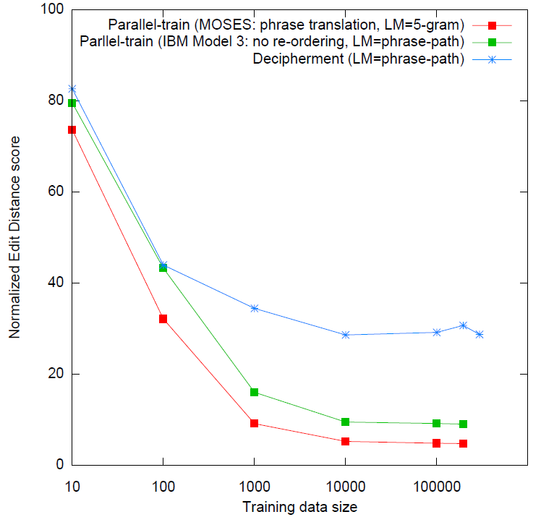
Deciphering Spanish Time Expressions
MT quality
on test set
(Edit distance,
lower is better)
no parallel data,
word-based MT
parallel data,
word-based MT
parallel data,
phrase-based MT
[Ravi & Knight 11]
local re-ordering

Slide 86
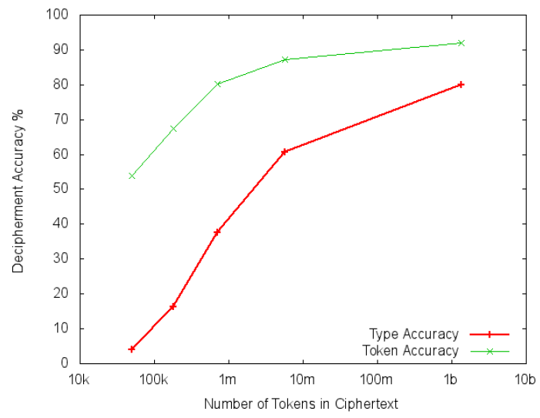
Scaling Up: Word Substitution
English word substitution cipher
Key method:
Slice sampling
[Dou & Knight 12]

Slide 87
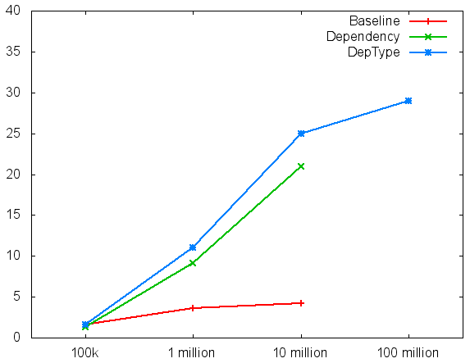
Scaling Up: Translation Dictionaries
Spanish as a cipher for English
Key method:
Dependency bigram model
Accuracy of learned
bilingual dictionary
[Dou & Knight 13]
[Dou & Knight 12]
Monolingual Spanish text (running words)

Slide 88
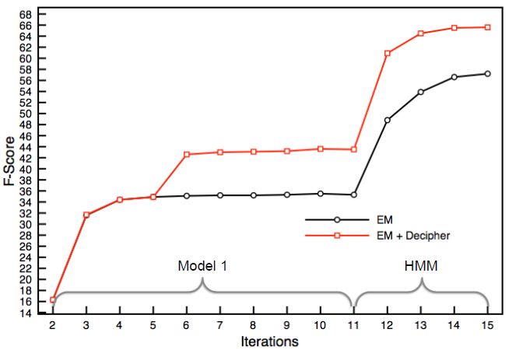
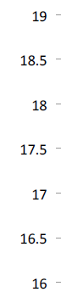
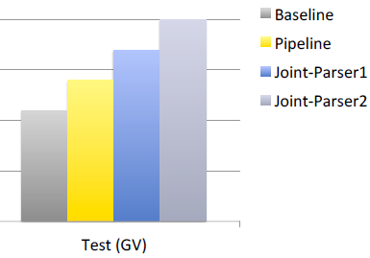
Scaling Up: Malagasy Translation
Small bilingual Malagasy/English text
(need to align words [Brown et al 93])
joint
Large Malagasy monolingual text
(need to decipher [Dou & Knight 13])
Decipherment helps
Word Alignment
Decipherment helps
Machine Translation

Slide 89
Plan for This Talk
Break a series of codes
Simple letter substitution
Phonetic substitution
archaeology
transliteration
Word substitution
Foreign language as cipher
Bonus
Two historical ciphers
Final thought on translation and cryptography
YOU
ARE
HERE

Slide 90
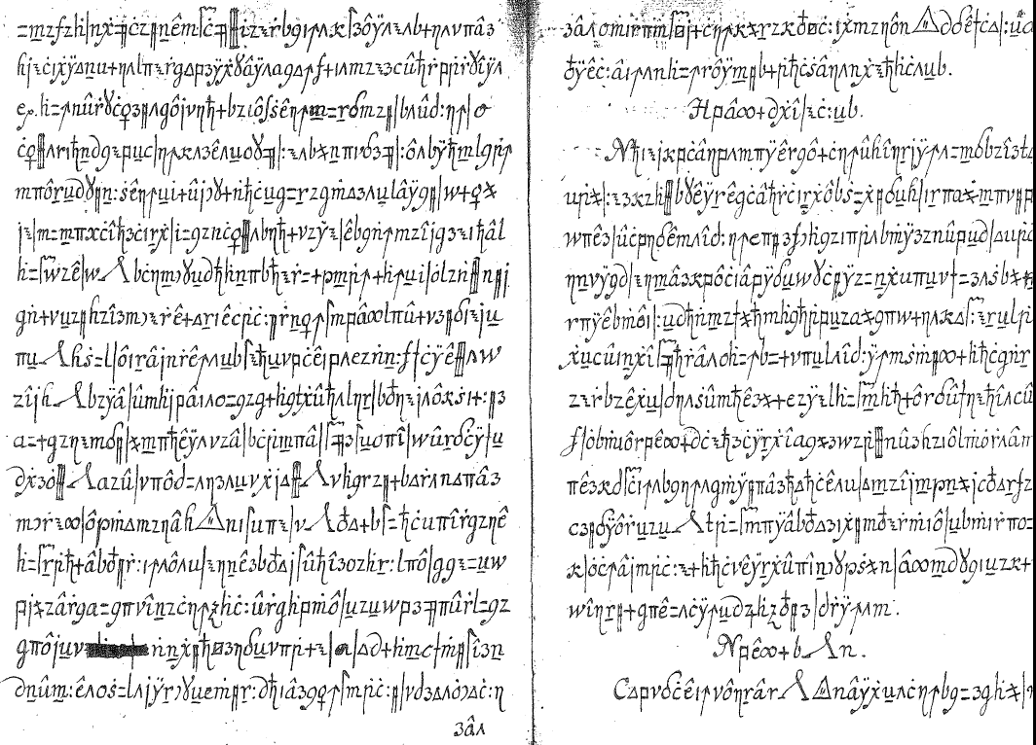
Copiale Cipher
[Knight, Megyesi, Schaefer 11]

Slide 91
Copiale Cipher
105 pages, 75000 letter tokens,
no word spacing, no illustrations.
Section headers
Lines ≈
equal length
Paragraphs and section titles
always begin with
capitalized Roman letters.
Non-enciphered inscriptions:
Copiales 3 and Philipp 1866
Some scratch-outs, rare
Preview text fragments
(“catchwords”)

Slide 92
Letter Frequencies
digraphs: trigraphs:
? - 99 ? - ^ 47
C : 66 C : G 23
- ^ 49 Y ? - 22
: G 48 y ? - 18
z ) 44 H C | 17
tendencies:
A, E, I, O, U followed by 3 and j
A, E, I, O, U preceded by z and >

Slide 93
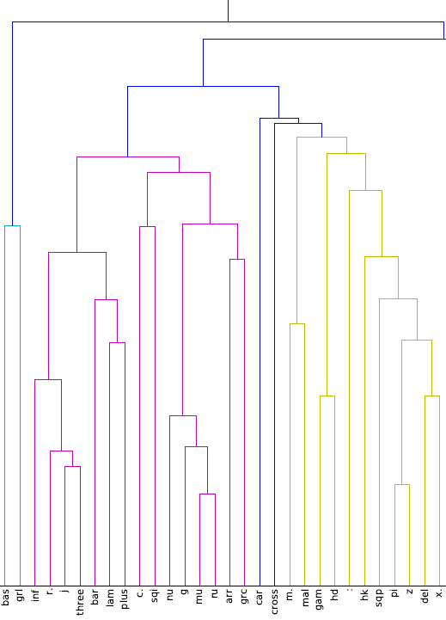
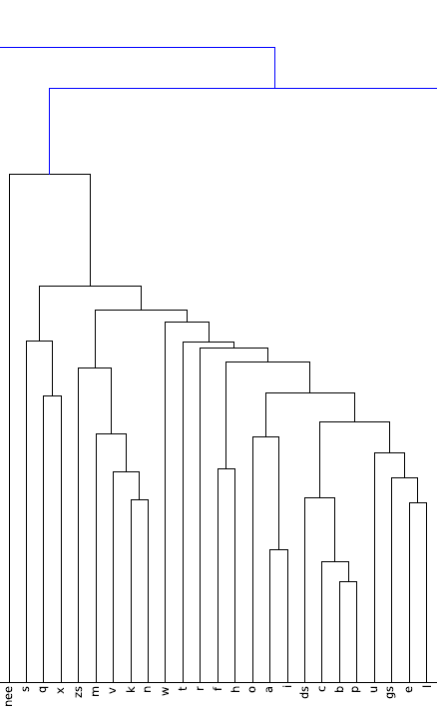
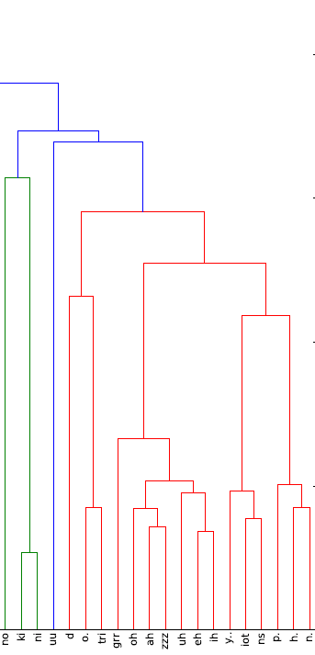
Clustering of Cipher Letters
letters grouped if they have similar contexts (L/R neighbors)
Scipy software
?]8R j 3 |^+C~DgBF/[4TM15-: 7Q >z6X9s qxJmvknwtrfhoai Lc bp uKei W”=Gd&<)OAZUEI y!Y PHN
thanks Jon Graehl

Slide 94
Clustering of Cipher Letters
letters grouped if they have similar contexts (L/R neighbors)
Scipy software
?]8R j 3 |^+C~DgBF/[4TM15-: 7Q >z6X9s qxJmvknwtrfhoai Lc bp uKei W”=Gd&<)OAZUEI y!Y PHN
underlined
letters
unaccented
Roman letters
circumflexed
vowels
thanks Jon Graehl

Slide 95
First Decipherment Approach
unaccented Roman
letters that cluster:
kMUF:pz!Of|y?-Ej-Z!^n>A3b#Kz=
j/lzGp0C^ARgk^-]R-]^ZjnQI|<R6)^a
=gzw>yEc#r1<+bzYR!XyjIFzGf9J
>"j/LP=~|U^S"B6m|ZYgA|k-=^-|lXO
W~:FI^b!7uMyjzvzAjx?PB>!zH^c1&gK
zU+p4]DXE3gh^-]j-]^I3tN"|rOyBA
+hHFzO3DbSY+:ZRkPQ6)-<CU^K=Dzk
QZ8nz)3f-NF>JEyDK=F>K1<3nz)|k
>Yj!XyRIg>G9bK^!Tb6U~]-3O^ezYO
|URc~306^bY-BL
a b c L e f K h i
k l m n o p q r s
t u v w x ( J
most common letter = 12%
least common = very small
kfnKlknacbfJmk
lbuvcKhtrhbkKDkn
fKKnkbKbecb ...
Decipher against
80 plaintext languages.

Slide 96
First Decipherment Approach
unaccented Roman
letters that cluster:
kMUF:pz!Of|y?-Ej-Z!^n>A3b#Kz=
j/lzGp0C^ARgk^-]R-]^ZjnQI|<R6)^a
=gzw>yEc#r1<+bzYR!XyjIFzGf9J
>"j/LP=~|U^S"B6m|ZYgA|k-=^-|lXO
W~:FI^b!7uMyjzvzAjx?PB>!zH^c1&gK
zU+p4]DXE3gh^-]j-]^I3tN"|rOyBA
+hHFzO3DbSY+:ZRkPQ6)-<CU^K=Dzk
QZ8nz)3f-NF>JEyDK=F>K1<3nz)|k
>Yj!XyRIg>G9bK^!Tb6U~]-3O^ezYO
|URc~306^bY-BL
a b c L e f K h i
k l m n o p q r s
t u v w x ( J
most common letter = 12%
least common = very small
kfnKlknacbfJmk
lbuvcKhtrhbkKDkn
fKKnkbKbecb ...
FAIL
Decipher against
80 plaintext languages.

Slide 97
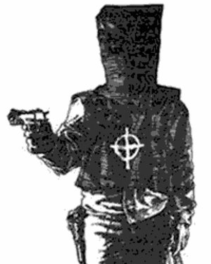
Second Decipherment Approach
Homophonic cipher,
e.g.:
A = 5 j l ( R
B = U
C = & D
D = ]
E = X f < “ _ I Z 3
F = Q
G = y
etc.
kMUF:pz!Of|y?-Ej-Z!^n>A3b#Kz=
j/lzGp0C^ARgk^-]R-]^ZjnQI|<R6)^a
=gzw>yEc#r1<+bzYR!XyjIFzGf9J
>"j/LP=~|U^S"B6m|ZYgA|k-=^-|lXO
W~:FI^b!7uMyjzvzAjx?PB>!zH^c1&gK
zU+p4]DXE3gh^-]j-]^I3tN"|rOyBA
+hHFzO3DbSY+:ZRkPQ6)-<CU^K=Dzk
QZ8nz)3f-NF>JEyDK=F>K1<3nz)|k
>Yj!XyRIg>G9bK^!Tb6U~]-3O^ezYO
|URc~306^bY-BL

Slide 98
Homophonic Cipher
Result of computer attack on Copiale, using 80 possible plaintext languages?
FAIL
But, slight numerical preference for German

Slide 99
Cipher Characteristics
digraphs: trigraphs:
? - 99 ? - ^ 47
C : 66 C : G 23
- ^ 49 Y ? - 22
: G 48 y ? - 18
z ) 44 H C | 17
tendencies:
A, E, I, O, U followed by 3 and j
A, E, I, O, U preceded by z and >
?
?
should appear
adjacent in German text
Make full digraph table for cipher and for German

Slide 100
Key Observation #1
In Copiale, ? almost always followed by –
In German, C almost always followed by H
(German CH is like English QU)
So guess: ? = C, –= H

Slide 101
One Thing Leads to Another
?–= CH → ?–^ = CHT → ^ = T ?
Each step is guesswork.
Must be willing to retract.
Weird task, not knowing German.
No longer care what the book says.
Cluster diagram crucial:
y = I → ! = I , Y = I
W”=Gd&<)OAZUEI y!Y PHN

Slide 102
Spring Break
2011

Slide 103
Spring Break
2011
German letters
Cipher
letters,
in groups
Grid

Slide 104
Spring Break
2011
German letters
Cipher
letters,
in groups
Grid
Quite a bit
of fooling
around →

Slide 105
Spring Break
2011
German letters
German
trigraphs
Cipher
trigraphs
Cipher
letters,
in groups
Grid
Trigraph
Decoding
Guesses
Quite a bit
of fooling
around →

Slide 106
Key Observation #2
unaccented Roman
letters that cluster:
kMUF:pz!Of|y?-Ej-Z!^n>A3b#Kz=
j/lzGp0C^ARgk^-]R-]^ZjnQI|<R6)^a
=gzw>yEc#r1<+bzYR!XyjIFzGf9J
>"j/LP=~|U^S"B6m|ZYgA|k-=^-|lXO
W~:FI^b!7uMyjzvzAjx?PB>!zH^c1&gK
zU+p4]DXE3gh^-]j-]^I3tN"|rOyBA
+hHFzO3DbSY+:ZRkPQ6)-<CU^K=Dzk
QZ8nz)3f-NF>JEyDK=F>K1<3nz)|k
>Yj!XyRIg>G9bK^!Tb6U~]-3O^ezYO
|URc~306^bY-BL
a b c L e f K h i
k l m n o p q r s
t u v w x ( J
Actually, those are space bars

Slide 107
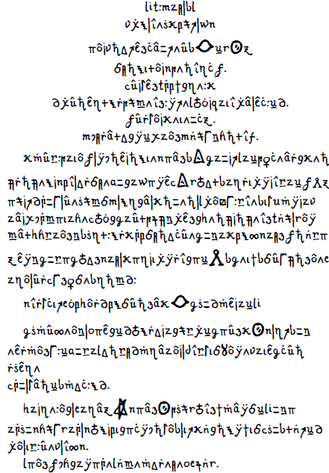
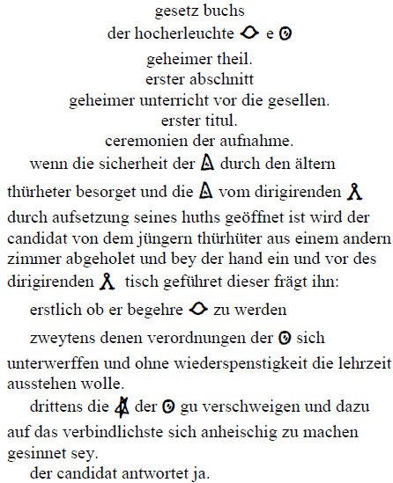
Copiale Decipherment

Slide 108
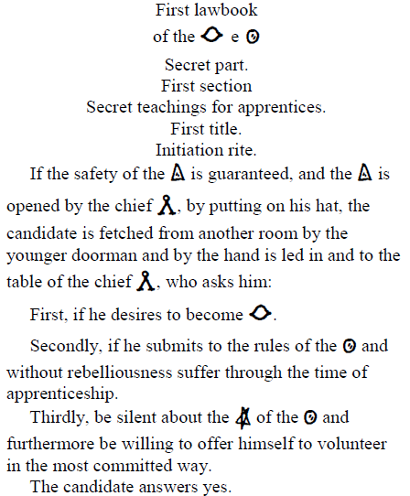
Copiale Decipherment

Slide 109
Copiale Decipherment
Documentation at
http://stp.lingfil.uu.se/~bea/copiale
Google: “copiale”

Slide 110
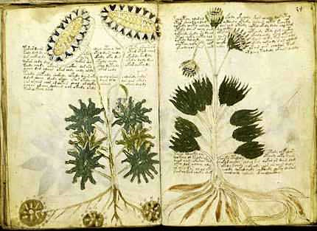
Voynich Manuscript
Medieval illustrated manuscript
235 pages, 6 sections, 38k word tokens, 35 letter types
Undeciphered

Slide 111
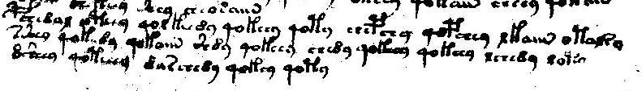
Voynich Manuscript
BSC8AE OPCC9 4OE FCC89 4OFCC9 4OP9 SCBS9 4OBSC9 EFAM OPAE29
2ZC9 4OFC89 4OFAM Z89 4OFCC9 SC89 4OFCC9 4OFCC9 ESC89 EOP9
8ZC9 4OPCCC9 8ARSC89 4OFC9 4OP9
BSC8AE OPCC9 4OE FCC89 4OFCC9 4OP9 SCBS9 4OBSC9 EFAM OPAE29
2ZC9 4OFC89 4OFAM Z89 4OFCC9 SC89 4OFCC9 4OFCC9 ESC89 EOP9
8ZC9 4OPCCC9 8ARSC89 4OFC9 4OP9

Slide 112
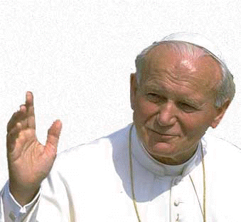
Voynich Letter Substitution
Latin letter trigram model
q u o _ v a d e _ b r e …
Input | Decipherment
VAS92 9FAE AR APAM ZOE ZOR9 QOR92 9 FOR ZOE89 … | quiss squm is onum pom quss hates s qum hatis …
a → {all Voynich letters}
b → {all Voynich letters}
c → {all Voynich letters}
…
z → {all Voynich letters}
_ → _
???
V A S 9 2 _ 9 F A E _ A R _ A P A M _ …

Slide 113

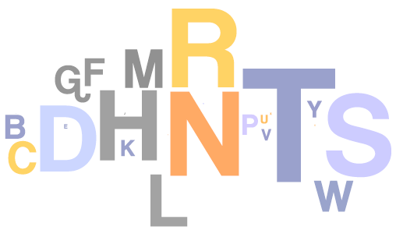
Letter Clustering
Trigram model over {a, b, _ }
a a _ b a b _ a b a a _ …
Sample tagging with learned model:
a b _ b b a _ b a b b _
i n _ t h e _ t o w n _
b b a b a _ a _ …
w h e r e _ i _ …
a →
b →
_ → _
i n _ t h e _ t o w n _ w h e r e _ i _ was …

Slide 114
Letter Clustering
Trigram model over {a, b, _ }
a a _ b a b _ a b a a _ …
Sample tagging with learned model:
? ? ? ? ? _ ? ? ? ? _ ? ? _
V A S 9 2 _ 9 F A E _ A R _
? ? ? ? _ ? ? ? _ ? ? ? ? _ …
A P A M _ Z O E _ Z O R 9 _ …
?
a → {all Voynich letters}
b → {all Voynich letters}
_ → _
?
V A S 9 2 _ 9 F A E _ A R _ A P A M _ …

Slide 115
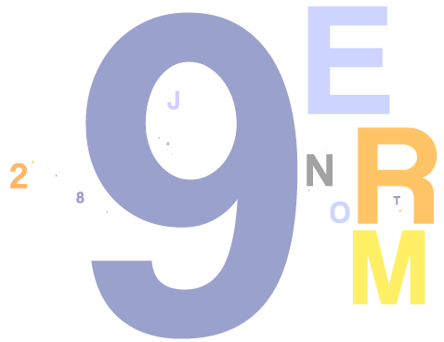
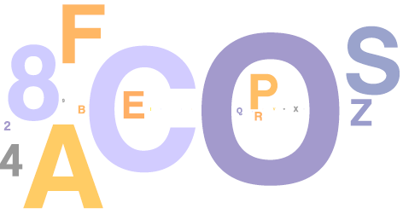
Letter Clustering
Trigram model over {a, b, _ }
a a _ b a b _ a b a a _ …
Sample tagging with learned model:
b b b b a _ a b b a _ b a _
V A S 9 2 _ 9 F A E _ A R _
b b b a _ b b a _ b b b a _ …
A P A M _ Z O E _ Z O R 9 _ …
a →
b →
_ → _
V A S 9 2 _ 9 F A E _ A R _ A P A M _ …

Slide 116



Letter Clustering
P(letter | tag)
P(tag | letter)
a →
b →
P(a)
English
P(a)
a →
b →
Voynich

Slide 117
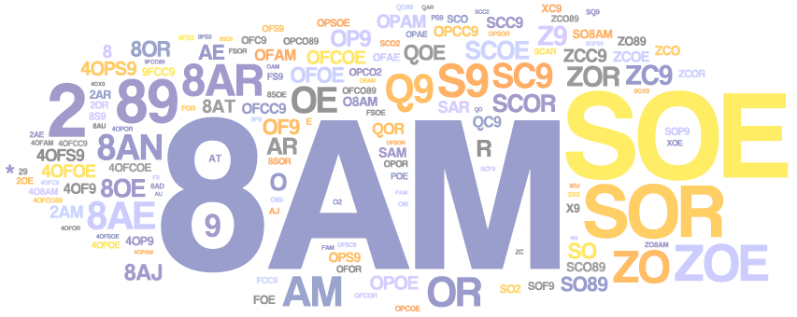
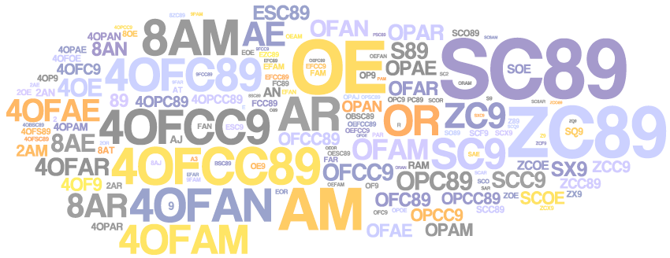
Word Clustering
Bigram model over {a, b}
Sample tagging with learned model:
a a a a a
VAS92 9FAE AR APAM ZOE
a a a a a …
ZOR9 QRC2 9 FOR ZOE89 …
a a b a b a b a a …
a →
b →
WAIT,
WHAT?
VAS92 9FAE AR APAM ZOE ZOR9 QRC2 9 ...

Slide 118
Word Clustering
Voynich words tagged as “a”
← pages →
Voynich words tagged as “b”

Slide 119
Word Clustering
Voynich words tagged as “a”
← pages →
Voynich words tagged as “b”
Herbal
Astro
Bio
Pharma
Stars
Voynich sections, per drawings observed.
Captain Currier’s “two languages” (1976).

Slide 120
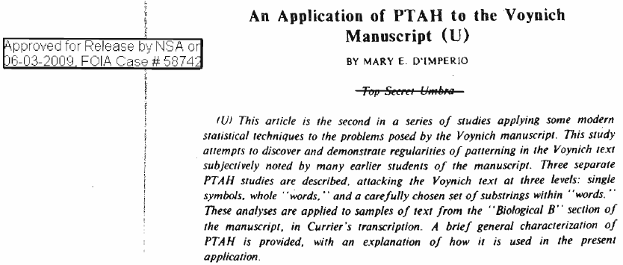
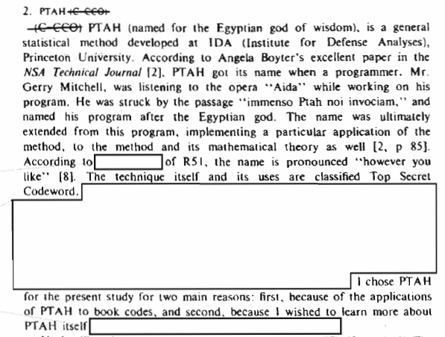
1970s NSA report
recently declassified!

Slide 121
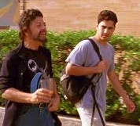
National Security Agency
Association for Computational Linguistics
NSA applies statistics to
ciphers, codes, and other
language processing problems
NSA employs more
mathematicians and
linguists than any other
organization.
NSA has more computers
than any other organization.
1950s
1960s
??
1970s paper on
HMM Voynich
1970s
1980s
1993 paper
on Statistical
Machine
Translation
1990s
Oh yeah -- we’ve been
on Mars since 1962!
ACL applies statistics
to language processing
problems
2000s
2010s
2011 paper on
HMM Voynich
2020s
“Slacker”

Slide 122

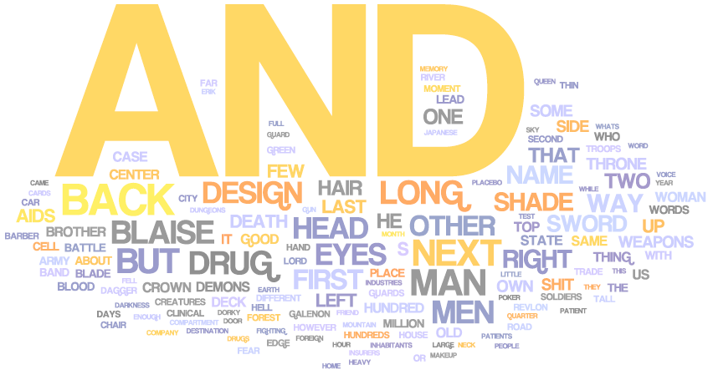
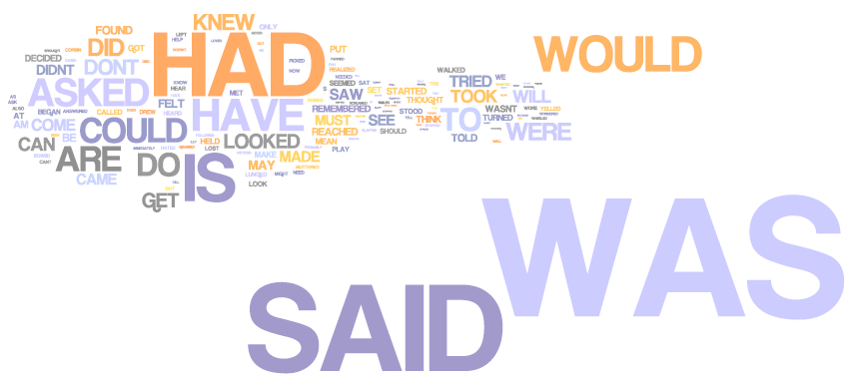
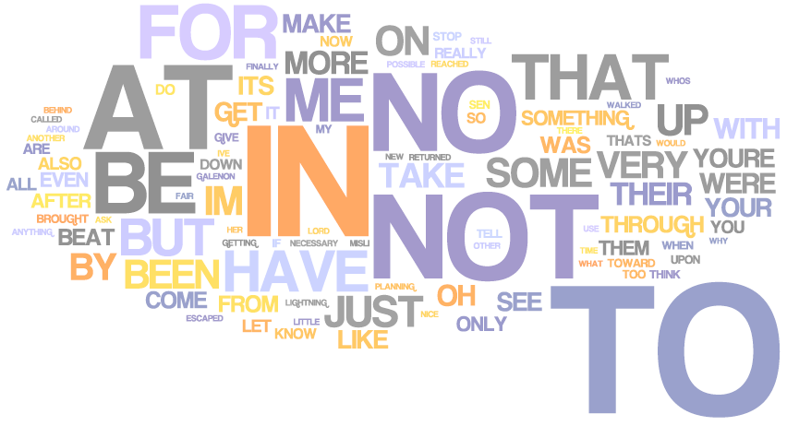
10-Class Word Clustering: English
etc
etc
etc
etc
etc
etc

Slide 123
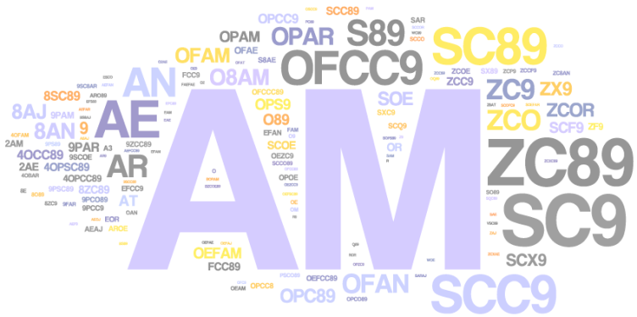
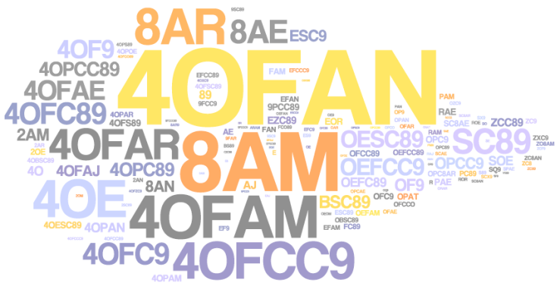
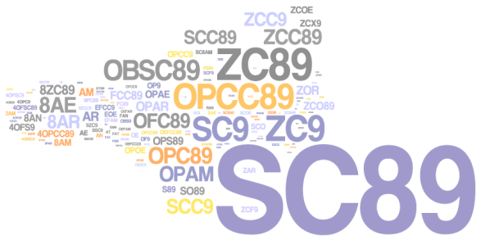
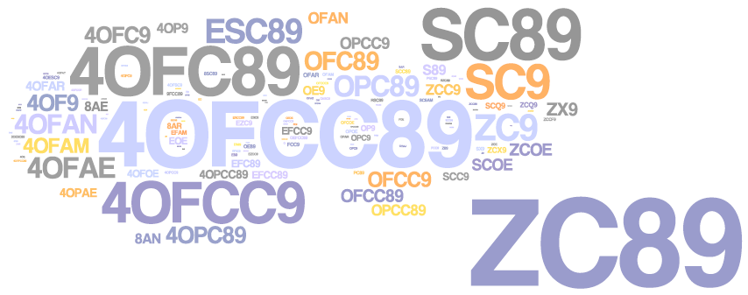
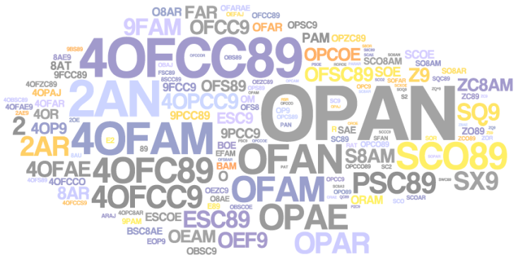
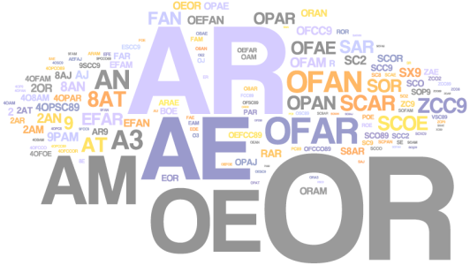




a
b
d
10 Classes:
Voynich-B
c
f
e
g
h
i
j

Slide 124




Other Unsolved Ciphers
Voynich Manuscript (1400)
Zodiac Killer (1967)
FBI cipher (1999)
Kryptos (1990)
Lost Language
Decipherment
Reddy &
Knight 11
Ravi & Knight 11
Snyder, Barzilay, Knight 10
Unsupervised
Training for NLP
OBKR
UOXOGHULBSOLIFBBWFLRVQQPRNGKSSO
TWTQSJQSSEKZZWATJKLUDIAWINFBNYP
VTTMZFPKWGDKZXTJCDIGKUHUAUEKCAR
Machine
Translation …

Slide 125
Plan for This Talk
Break a series of codes
Simple letter substitution
Phonetic substitution
archaeology
transliteration
Word substitution
Foreign language as cipher
Bonus
Two historical ciphers
Final thought on translation and cryptography
YOU
ARE
HERE

Slide 126




Future Prospects for Translation
 | Cryptography | Translation
Manual | Manual encoding | Human translation
Mechanical | Mechanical encoding; intuition-based decryption
Mathematical | Computer decryption, based on information theory
Higher math, deeper understanding | Public-key systems, based on number theory
1920s
1950s
1980s

Slide 127
Future Prospects for Translation
 | Cryptography | Translation
Manual | Manual encoding | Human translation
Mechanical | Mechanical encoding; intuition-based decryption | Rule-based MT
Mathematical | Computer decryption, based on information theory | Statistical MT
Higher math, deeper understanding | Public-key systems, based on number theory | ??? ??? ???
1920s
1960s
1950s
1990s
1980s
2020s

Slide 128
end

Slide 129


Zodiac Killer Ciphers
Zodiac 408 (solved, 1969)
Zodiac 340 (still unsolved)

Slide 130


Zodiac Serial Killer
408-letter cipher (solved):
(plus two more sections)

Slide 131

Zodiac Serial Killer
Plaintext solution
Plaintext has many misspellings
Final 18 plaintext characters of 408 are “junk”

Slide 132
Deciphering Zodiac 408 Bayesian models
Extended Carmel finite-state toolkit to do Bayesian inference.
[Chiang et al 10]
Language Model | Initial Sample | Decipherment Error
3-gram | Random | 62.3 / 48.5 / 47.4
5-gram | Random | all wrong!
“ | 3-gram solution | 42.6
Word 1-gram | Random | all wrong!
Interpolated 5-gram and word 1-gram | Random | 79.2
“ | 5-gram solution | 3.3 / 2.6
[Ravi & Knight 11]

Slide 133
Unsolved Zodiac 340
Has no obvious reading order bias:
Could be nonsense … or maybe bigrams are smoothed out via
more careful substitutions.
% cipher bigram types that repeat (freq > 1) | Left/ Right order | Up/ Down order | Diag. North-East | Diag. South- East
Zodiac 408 (solved) | 13 % | 5 | 7 | 5
Zodiac 340 (unsolved) | 7 | 6 | 8 | 5

Slide 134
Decipherment Papers by ACL-ers
"Unsupervised Analysis for Decipherment Problems,“ (K. Knight, A. Nair, N. Rathod, and K. Yamada), Proc. ACL-COLING, 2006. (Rejected four times previously, but OK!)
"Attacking Decipherment Problems Optimally with Low-Order N-gram Models," (S. Ravi and K. Knight), Cryptologia, 2009.
"Probabilistic Methods for a Japanese Syllable Cipher," (S. Ravi and K. Knight), Proc. ICCPOL, 2009.
"A Statistical Model for Lost Language Decipherment," (B. Snyder, R. Barzilay, and K. Knight), Proc. ACL, 2010.
"An Exact A* Method for Deciphering Letter-Substitution Ciphers," (E. Corlett and G. Penn), Proc. ACL, 2010.
"Deciphering Foreign Language," (S. Ravi and K. Knight), Proc. ACL, 2011.
"The Copiale Cipher," (K. Knight, B. Megyesi, and C. Schaefer), Proc. ACL BUCC, 2011.
"Bayesian Inference for Zodiac and Other Homophonic Ciphers," (S. Ravi and K. Knight), Proc. ACL, 2011.
"What We Know About the Voynich Manuscript," (S. Reddy and K. Knight), Proc. ACL LaTECH, 2011.
"Simple Effective Decipherment via Combinatorial Optimization," (T. Berg-Kirkpatrick and D. Klein), Proc. EMNLP, 2011.
"Decoding Running Key Ciphers," (S. Reddy and K. Knight), Proc. ACL, 2012.
"Large Scale Decipherment for Out-of-Domain Machine Translation," (Q. Dou and K. Knight), Proc. EMNLP, 2012.
"Deciphering Foreign Language by Combining Language Models and Context Vectors," (M. Nuhn, A. Mauser, and H. Ney), Proc. ACL, 2012.
"Decipherment Complexity in 1:1 Substitution Ciphers," (M. Nuhn, and H. Ney), Proc. ACL, 2013.
"Beam Search for Solving Substitution Ciphers," (M. Nuhn, J. Schamper, and H. Ney), Proc. ACL, 2013.
"Scalable decipherment for machine translation via hash sampling," (S. Ravi), Proc. ACL, 2013.
“Unsupervised Consonant-Vowel Prediction over Hundreds of Languages,” (Y. Kim and B. Snyder), Proc. ACL, 2013.

Slide 135
Word Substitution Cipher
………….France………Britain………………Canada……………Mexico………………Indonesia……Malaysia……………….Britain………..Canada………..Australia……..Britain………….France…………….Indonesia………….Mexico………………Australia…………….France……Britain……………………………………….
Key Point: These texts are
not related to each other.
TRAIN
………….knd!………bryT!ny!………………knd!………………!lmksyk…………………….………!ndwnysy!……!lmksyk……………….bryT!ny…..!m!lyzy!………..bryT!ny!……..frns!………….!str!ly!…….!ndwnysy!………….frns!………………frns!……….frns!……bryT!ny!……………………!str!ly!……………
?
plaintext e
P(sentence has w1 |
sentence has w2)
P(f | e) =
7 x 7 subst table
[Knight et al 06]

Slide 136
Word Substitution Cipher
………….France………Britain………………Canada……………Mexico………………Indonesia……Malaysia……………….Britain………..Canada………..Australia……..Britain………….France…………….Indonesia………….Mexico………………Australia…………….France……Britain……………………………………….
Key Point: These texts are
not related to each other.
TRAIN
………….knd!………bryT!ny!………………knd!………………!lmksyk…………………….………!ndwnysy!……!lmksyk……………….bryT!ny…..!m!lyzy!………..bryT!ny!……..frns!………….!str!ly!…….!ndwnysy!………….frns!………………frns!……….frns!……bryT!ny!……………………!str!ly!……………
?
plaintext e
P(sentence has w1 |
sentence has w2)
P(f | e) =
7 x 7 subst table
Australia → !str!ly! (0.93) !ndwnysy! (0.03) m!lyzy! (0.02)
Britain → bryT!ny! (0.98) !ndwnysy! (0.01) !str!ly! (0.01)
Canada → knd! (0.57) frns! (0.33) m!lyzy! (0.06)
France → frns! (1.00)
Indonesia → !ndwnysy! (1.00)
Malaysia → m!lyzy! (0.93) lmksyk (0.07)
Mexico → !lmksyk (0.91) m!lyzy! (0.07)
[Knight et al 06]

